Slide 1
딥러닝 이해 및 활용 #PA2
컴퓨터소프트웨어학과 석사 2기
2023106745 안현석
GitHub

Slide 2
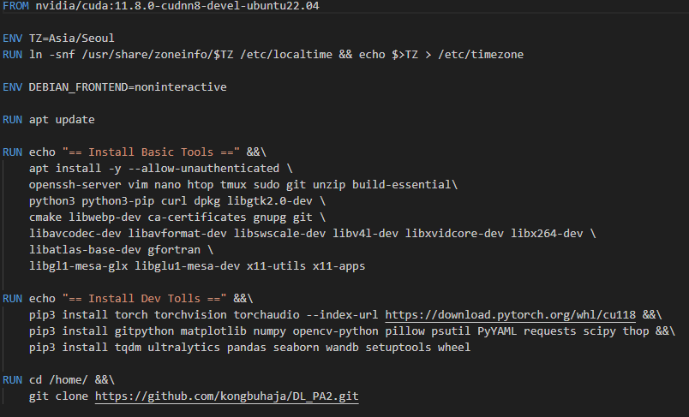
[Environment] 환경설정
Docker build file을 통해 환경설정

Slide 3
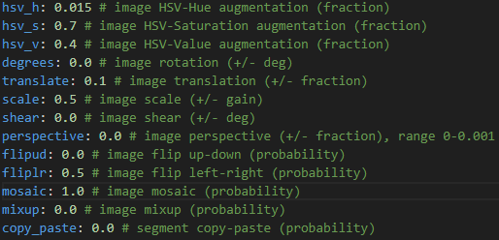
[TODO] Data augmentation
Do you think that the augmentation is effective?
적당한 augmentation은 다양한 데이터를 만들어, 학습에 도움을 준다.
augmentation | Low | high
mAP50 | 0.3247 | 0.3312
mAP | 0.1516 | 0.1555

Slide 4
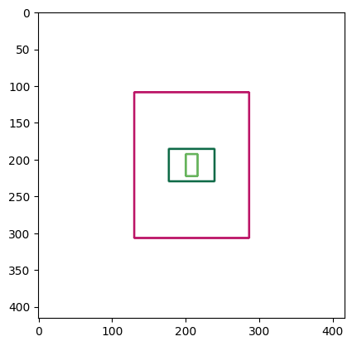
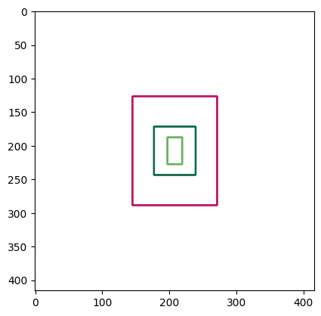
[TODO] Draw anchors
Original anchors
[[16, 30], [62, 45], [156, 198]]
New anchors
[[22, 40], [62, 73], [126, 162]]

Slide 5
[TODO] Draw anchors
Generate new anchor
Original
Kmeans with IoU
Kmeans + Ransac with IoU
 | Original | Kmeans | +Ransac(0.3) | +Ransac(0.5) | +Ransac(0.7)
mAP50 | 0.3247 | 0.3194 | 0.3107 | 0.3216 | 0.3192
mAP | 0.1516 | 0.1532 | 0.1457 | 0.1551 | 0.1530

Slide 6
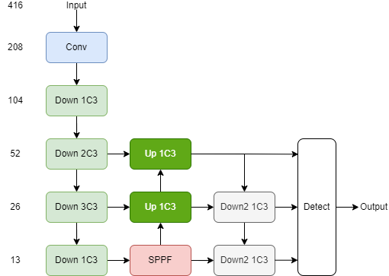
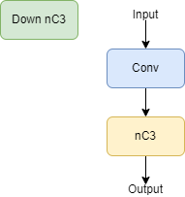
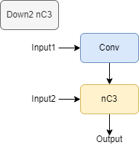
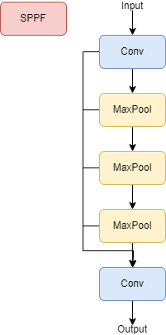
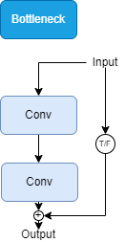
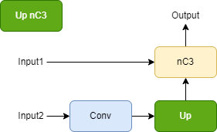
[TODO] Draw architecture
YOLOv5n architecture

Slide 7
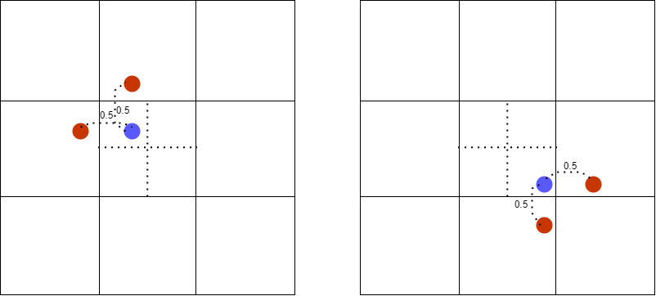
[TODO] Training targets
One-to-many label assignment method.
X, Y좌표가 0.5보다 작으면 -0.5, 크면 +0.5 위치에 positive sample을 할당한다.

Slide 8
[TODO] Qualitative evalutation
Run inference

Slide 9
[TODO] Improve performance
Change block architecture
block | C3 | C2f | C2fC | C3x
mAP50 | 0.3312 | 0.3164
mAP | 0.1555 | 0.1491

Slide 10
[TODO] Best Model
YOLOv5n based
Ransac(0.5) + kmeans
Augmentation high
Change architecture(C3)
 | base | best
mAP50 | 0.3247
mAP | 0.1516

